Slide 1

React, JAVA e AWS cloud, criando um crud e fazendo upload de imagens para S3

Slide 2

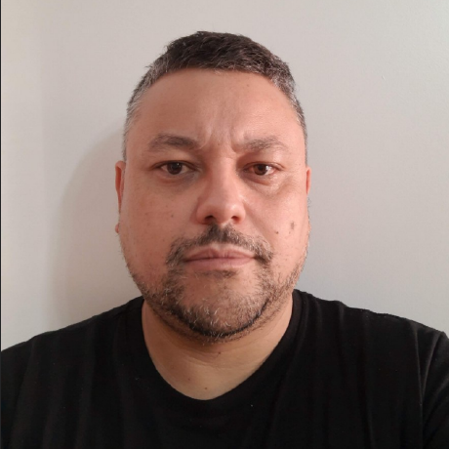
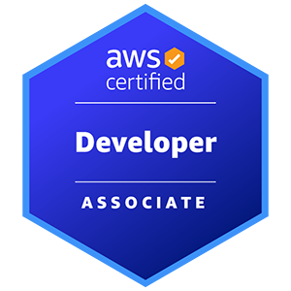
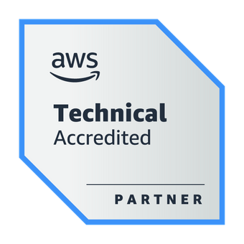


Weder Mariano de Sousa
Center Leader Specialist Senior - NTTDATA
GOJava
AWS User Group Goiânia
https://www.linkedin.com/in/wedermarianodesousa/
https://github.com/weder96

Slide 3
Agenda
Building Apps
App Integration
AI/ML
CDK for Complex Enterprise Applications
Eric Z. Beard and Rico Huijbers

Slide 4

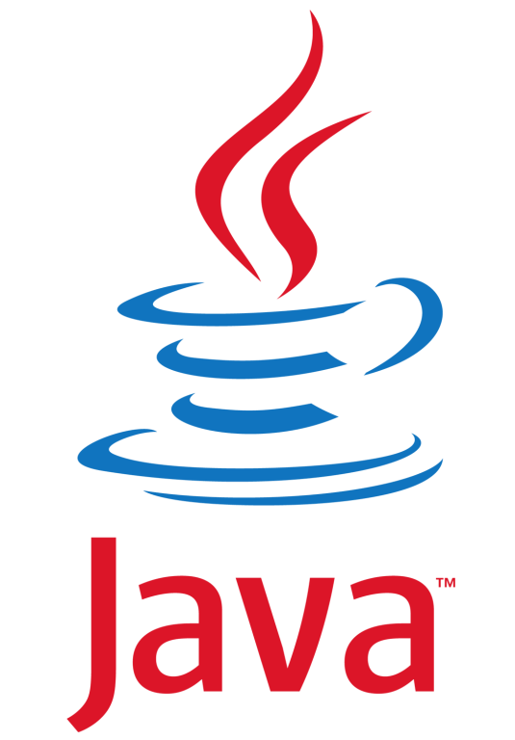

Archicteture
FrontEnd
BackEnd
AWS
React
Java
S3

Slide 5
Archicteture
FrontEnd
BackEnd
AWS
http
CDK
http
CDK
React
Java
S3

Slide 6
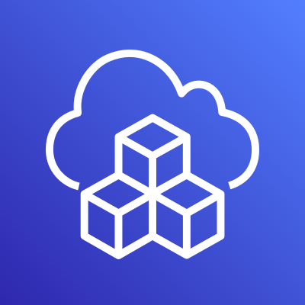
What is AWS CDK?
The AWS Cloud Development Kit (AWS CDK) is an open-source software development framework for defining cloud infrastructure as code with modern programming languages and deploying it through AWS CloudFormation.
https://aws.amazon.com/cdk/faqs/
https://aws.amazon.com/cdk/?nc1=h_ls

Slide 7
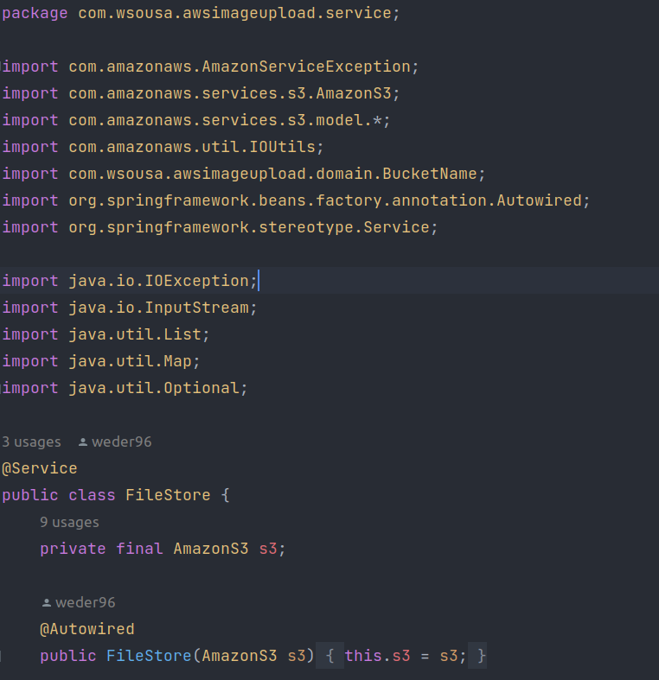
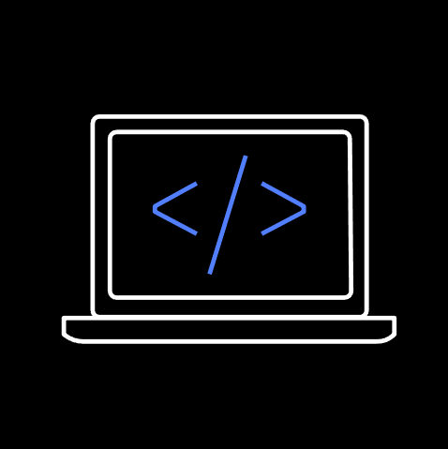

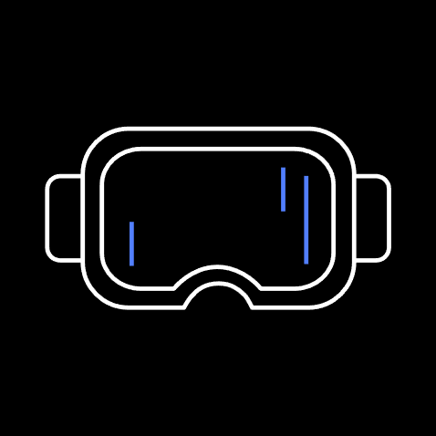



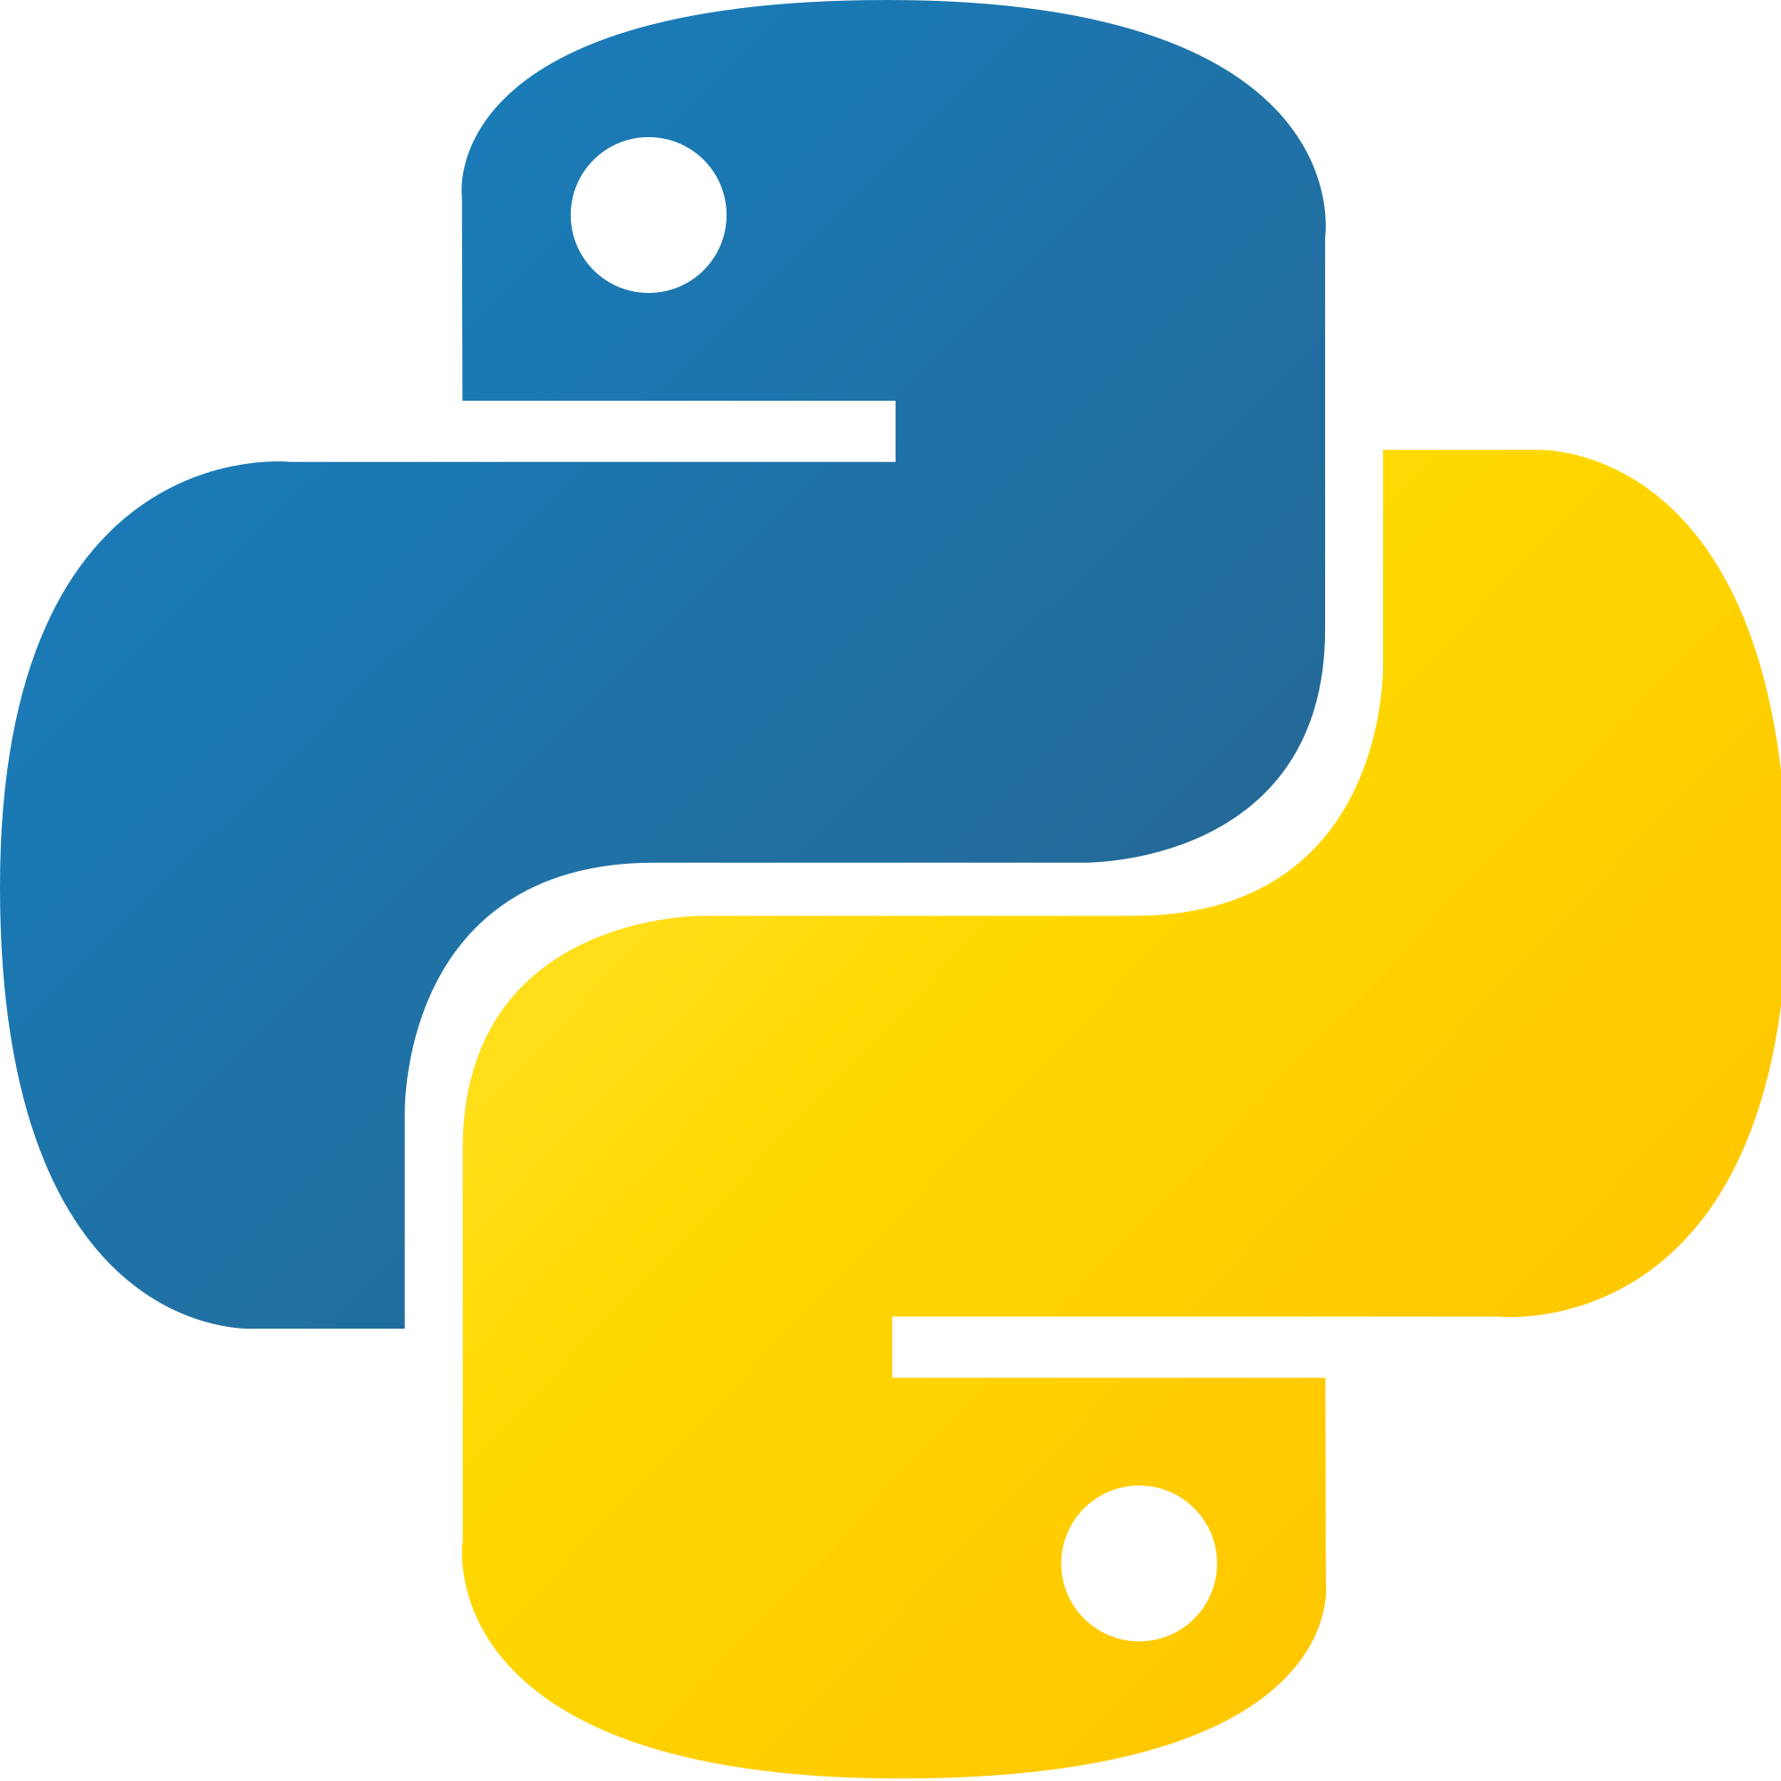
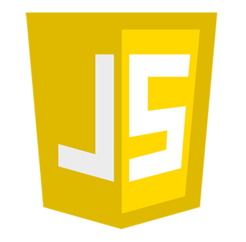

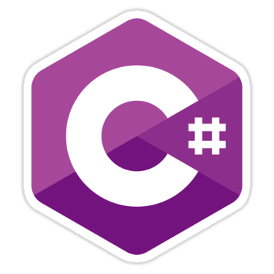


AWS Cloud Development Kit (CDK)
A multi-language software development framework for modeling cloud infrastructure as reusable components
COMING
SOON!

Slide 8
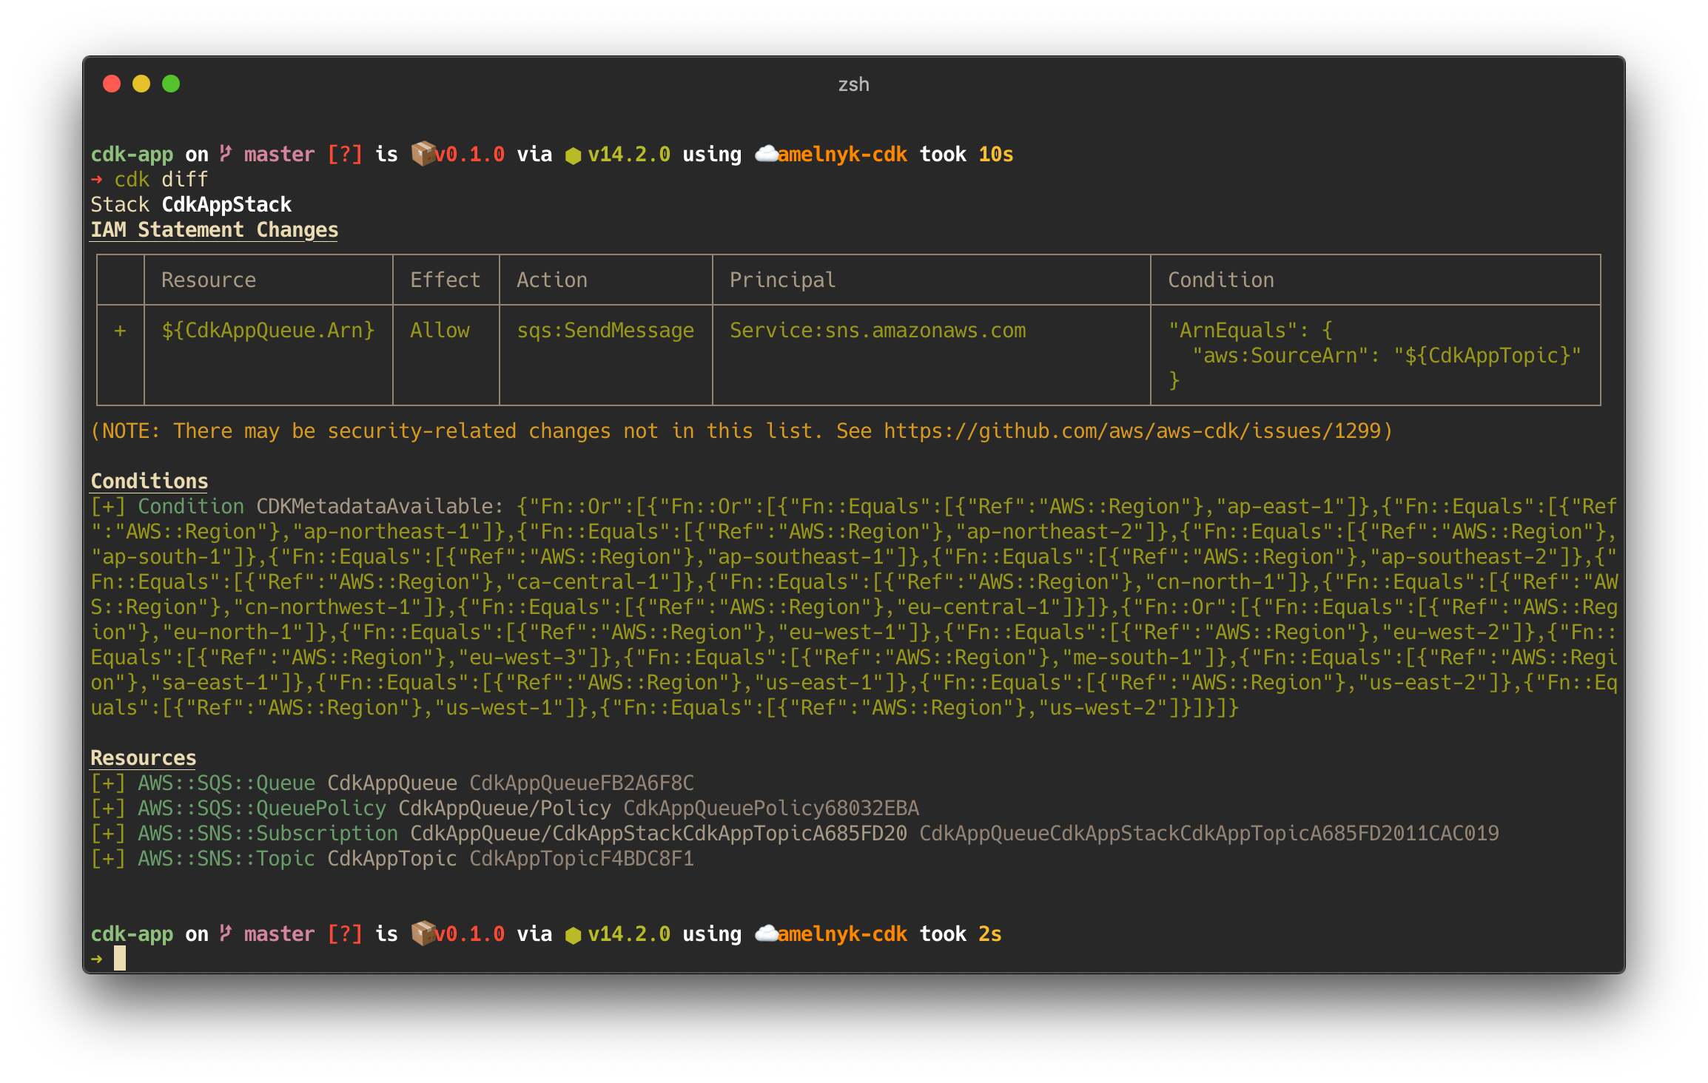



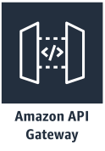
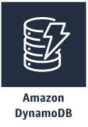
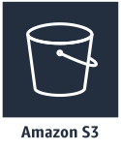


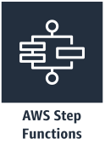

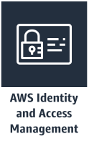



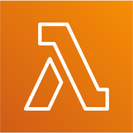
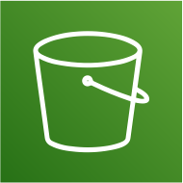



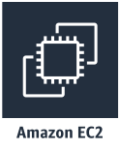
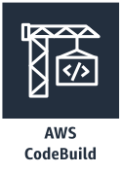
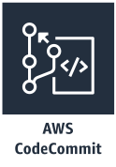
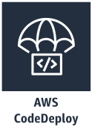
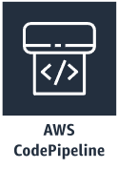
Main Components
App
Serverless
App Integration / Foundational Services
Stacks
Containers
CI/CD
Resources
Core Framework
AWS Construct Library
AWS CDK CLI

Slide 9

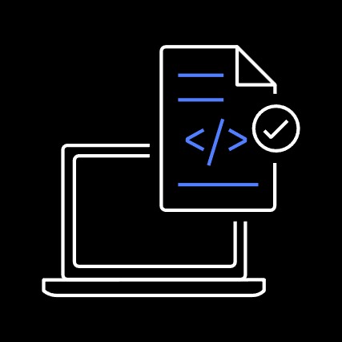
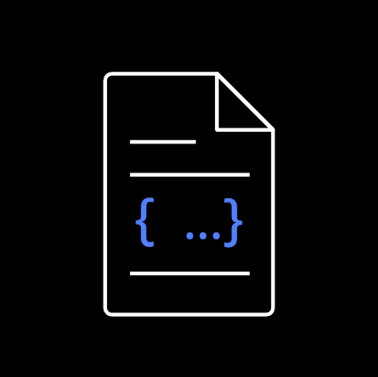

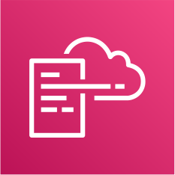
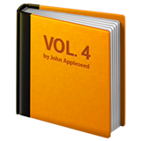




Development Workflow
execute
synthesize
deploy
provision
Stacks & Constructs
Source Code
CDK CLI
Templates + Assets
Cloud Assembly
AWS CloudFormation
Cloud Resources
cdk init
// create new project
npm run build
// build project
cdk synth
// create templates and assets
cdk diff
// check what will change
cdk deploy
// push changes to your account
https://www.youtube.com/watch?v=R7wSTZ54gNk&t=261s
© 2020, Amazon Web Services, Inc. or its Affiliates. All rights reserved. Amazon Confidential and Trademark.

Slide 10
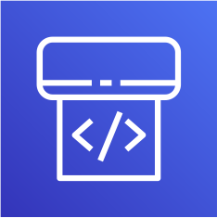
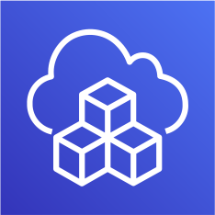



Best Practice – Deploy to multiple accounts
Shared Services Account
Fubuki’s Account
Saitama’s Account
pipeline
cdk deploy
source control
git push
Beta Account
Prod Account
Fubuki
Saitama
Gamma Account

Slide 11
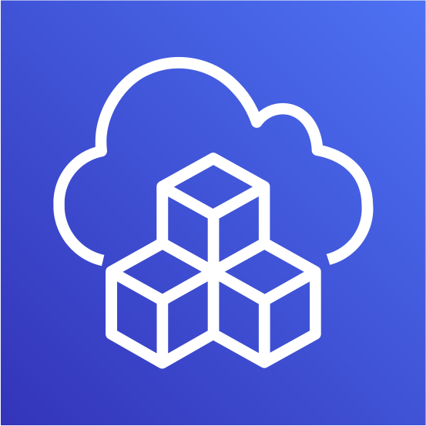

Application Development

Slide 12
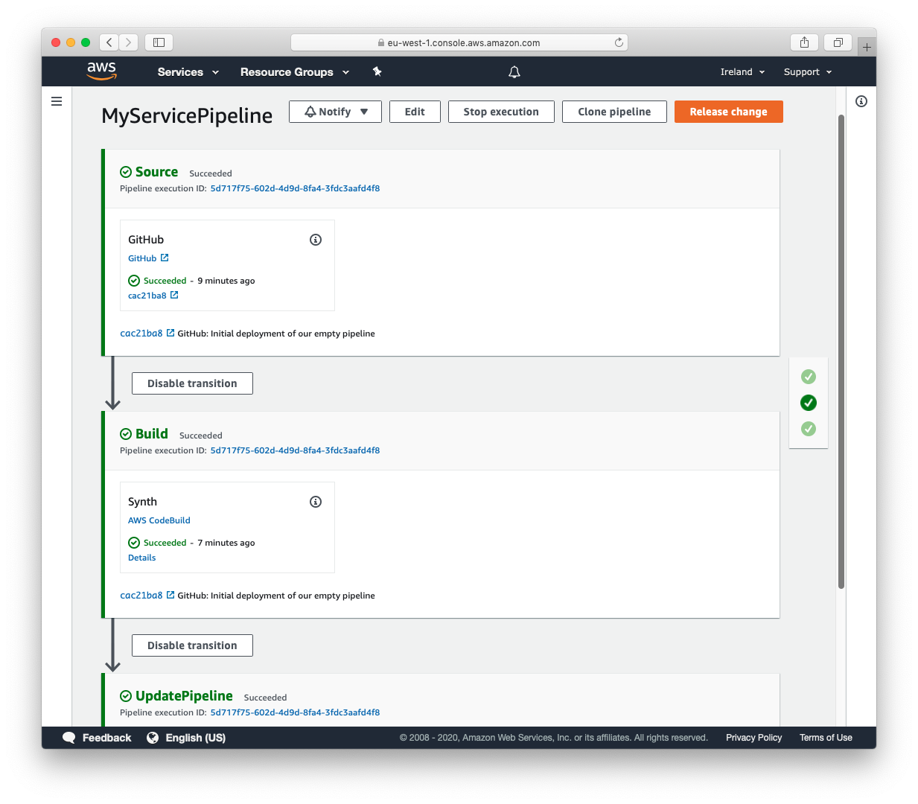
CDK Pipelines
Continuous delivery for AWS CDK applications
Model continuous delivery pipelines as part of your infrastructure code.
Easily model cross-account and cross- region pipeline configurations.
Pipelines are self modifying as
you push your CDK code to origin.

Slide 13
NEW
AWS Cloud Development Kit (CDK) v2
Consolidated construct library (aws-cdk-lib), experimental modules distributed separately. New CDK Watch functionality.
Generally AVAILABLE TODAY
For JavaScript, TypeScript, Java, Python, .NET and Go.
DOP315 - What's new with AWS CloudFormation and AWS CDK
Notes:
docs.aws.amazon.com/cdk/v2/guide/migrating-v2.html
AWS CDK V2 – defines a consolidated construct Library so its easier to stay up to date
AWS CDK v2 only includes stable APIs, which comply with Semantic Versioning (semver), so you can confidently update to new minor versions. The CDK follows the “release early, release often” philosophy to encourage community participation, and we will continue deliver new features via experimental APIs for your feedback. However, going forward, experimental modules will be distributed separately from aws-cdk-lib, versioned clearly to indicate their pre-release status, and will only be merged into aws-cdk-lib when mature and stable.
In addition to simplified packing, the CDK includes developer productivity improvements such as a CDK API reference refresh with code snippets throughout, CDK Watch for faster inner-loop development iterations on the application code (AWS Lambda handler code, Amazon ECS tasks, and AWS Step Function state machines) in your CDK project. You can also preserve successfully provisioned resources by disabling automatic stack rollbacks, further reducing deployment and iteration time. To find issues earlier in your infrastructure code development cycle, you can use the new assertions library to run automated unit tests in any CDK-supported language.
Has a migration path from V1 created stack
Migrating from V1 instructions - docs.aws.amazon.com/cdk/v2/guide/migrating-v2.html

Slide 14
Difference between v2 and v1
CDK v1
CDK v2
"dependencies": {
"@aws-cdk/aws-amplify": "^1.125.0",
"@aws-cdk/aws-appsync": "^1.125.0",
"@aws-cdk/aws-codepipeline": "^1.125.0",
"@aws-cdk/aws-cognito": "^1.125.0",
"@aws-cdk/aws-lambda": "^1.125.0",
"@aws-cdk/aws-sns": "^1.125.0",
"@aws-cdk/core": "1.125.0",
"@aws-cdk/pipelines": "^1.125.0",
}
"dependencies": {
"aws-cdk-lib": "2.0.0",
"constructs": "^10.0.0",
"@aws-cdk/aws-iot-alpha": "^2.0.0-alpha.0"
}
import { App, Stack } from "@aws-cdk/core";
const lambda = require("@aws-cdk/aws-lambda");
import { App, Stack } from "aws-cdk-lib";
const s3 = require("aws-cdk-lib/aws-s3");
Notes:
In this example you can see how the packaging between v1 and 2 differs.
This example is using typescript and you can see that in the package json the amount of dependencies we need to import is very long.
When ever we update the version of CDK we need to update all the versions of all the dependencies. This is quite tedious work.
In the case of v2 there is only one package for all the libraries and then if we want to use some experimental construct we can just import that library with the specific version we are interested in.

Slide 15
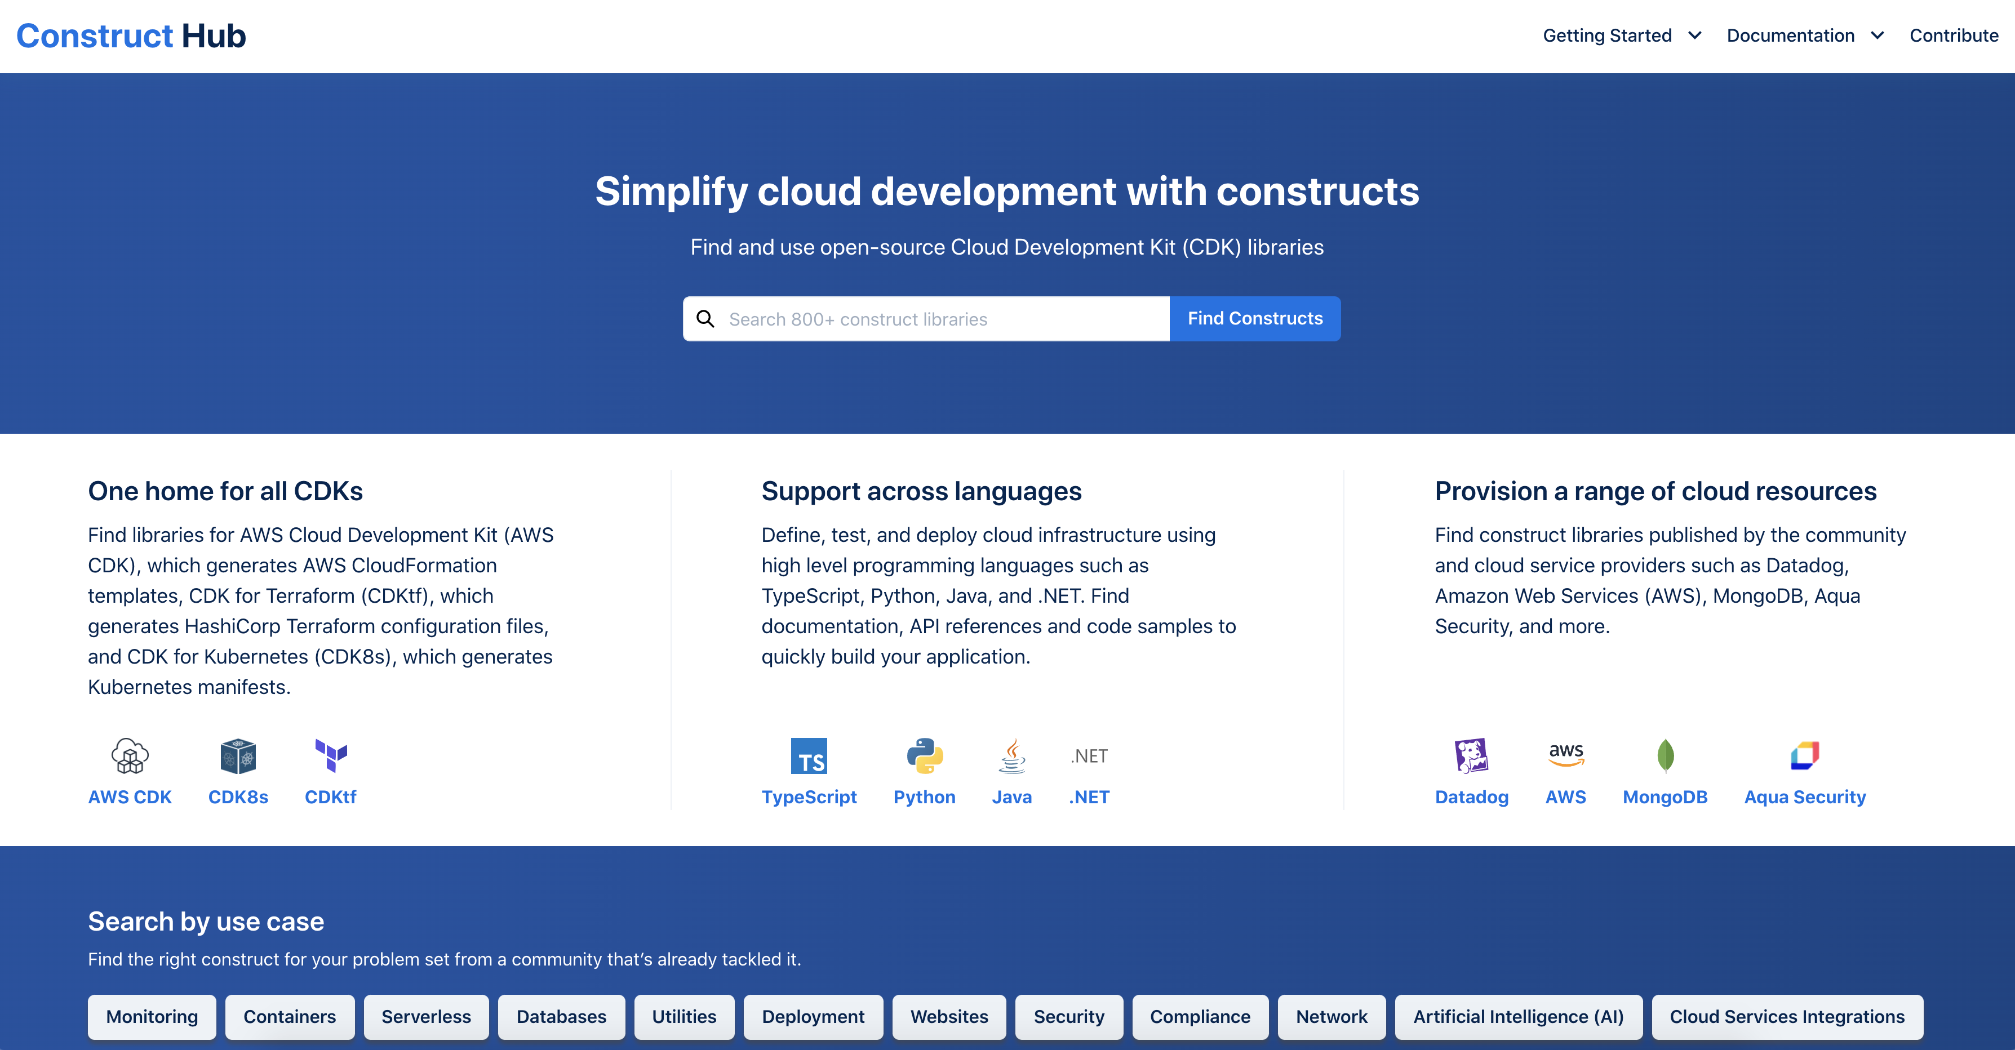
NEW
https://constructs.dev
AWS CDK
Construct Hub
Share open-source construct libraries with the wider cloud development community.
Generally AVAILABLE TODAY
https://aws.amazon.com/pt/blogs/developer/construct-hub-preview/
Notes:
https://constructs.dev
To more easily share with the community your CDK Constructs
You can find construct libraries published by the community, AWS and cloud service providers that solve for your use case: monitoring, containers, serverless, databases, utilities, deployment, websites, security, compliance, network, artificial intelligence (AI), cloud service integrations and more. Each library includes documentation, API reference and code samples in TypeScript, Python, Java and .NET. You can also find installation instructions for each programming language, dependency list, number of downloads, licensing information, and helpful links.

Slide 16
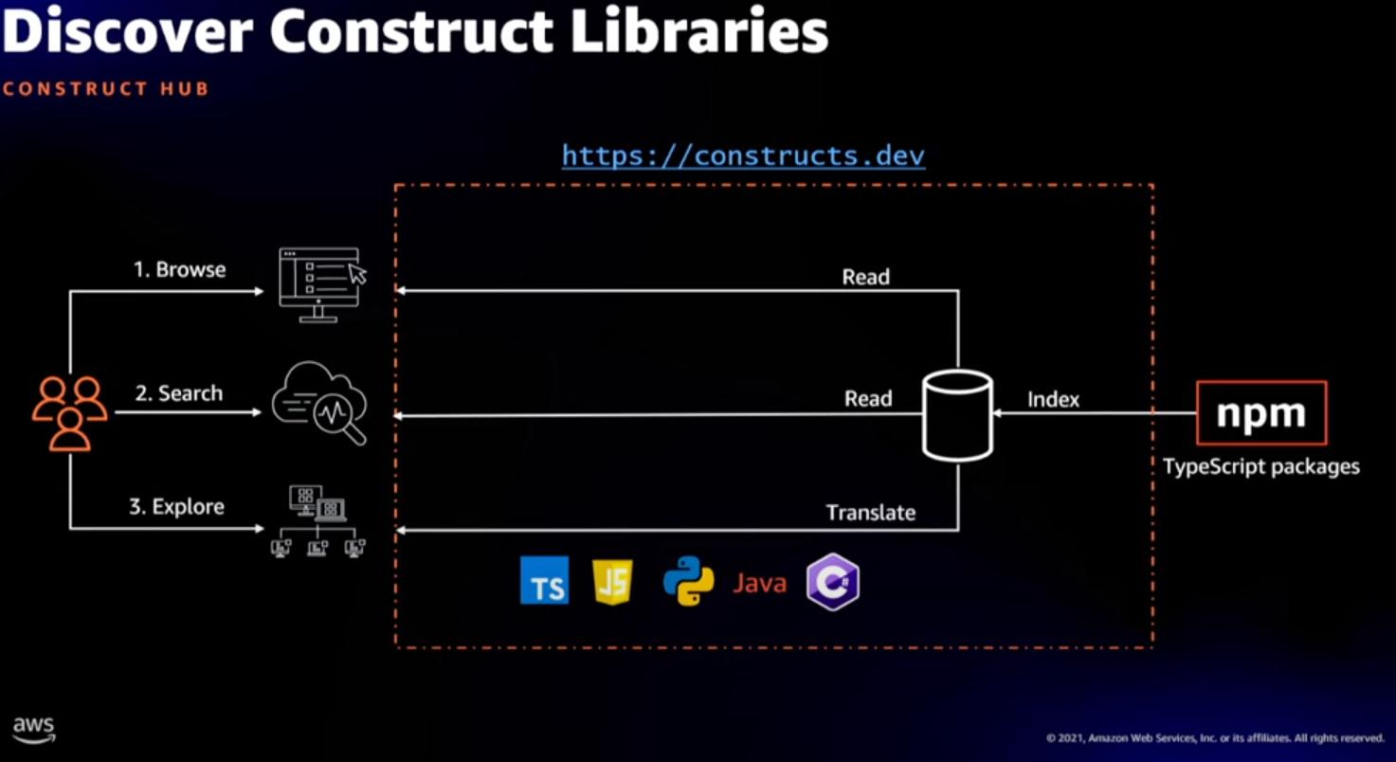
AWS CDK Construct Hub
Generally AVAILABLE TODAY
NEW
https://aws.amazon.com/pt/blogs/developer/construct-hub-preview/
Notes:
https://constructs.dev
To more easily share with the community your CDK Constructs
You can find construct libraries published by the community, AWS and cloud service providers that solve for your use case: monitoring, containers, serverless, databases, utilities, deployment, websites, security, compliance, network, artificial intelligence (AI), cloud service integrations and more. Each library includes documentation, API reference and code samples in TypeScript, Python, Java and .NET. You can also find installation instructions for each programming language, dependency list, number of downloads, licensing information, and helpful links.

Slide 17
Talking is easy,
show me the code.

Slide 18
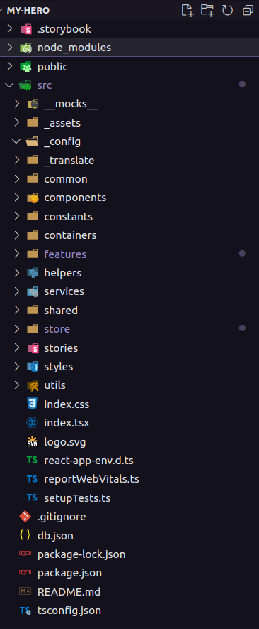

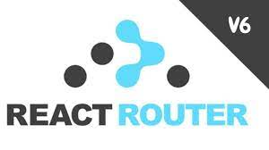


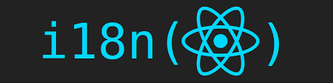

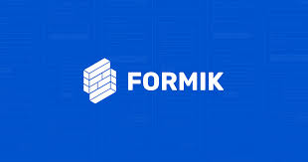
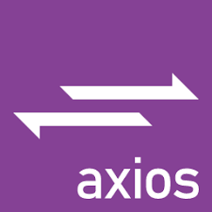
Archicteture FrontEnd
FrontEnd
Mode Dark
Breadcumbs
Loading
Toast Messages

Slide 19
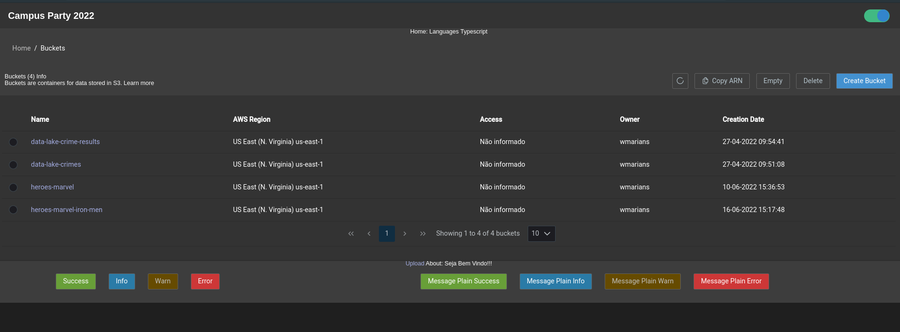
List Buckets

Slide 20
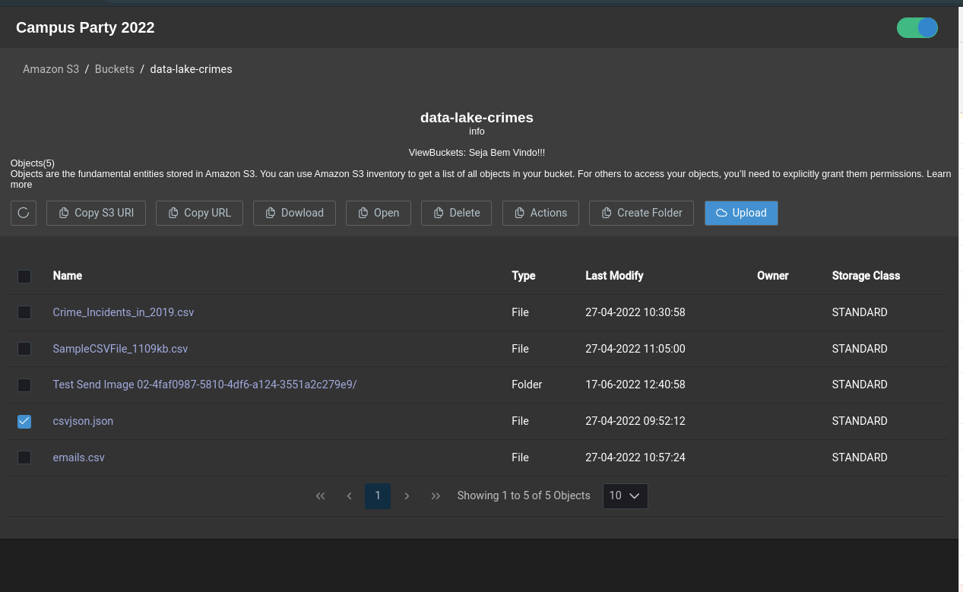
List Objects

Slide 21
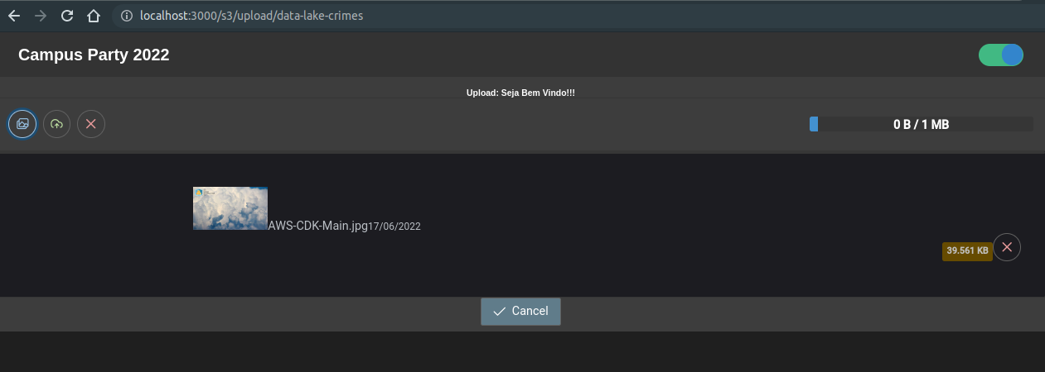
Upload Files - S3

Slide 22
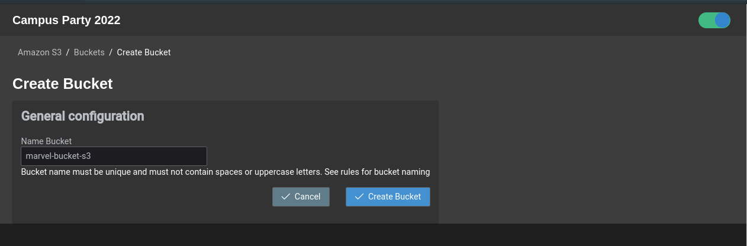
Create Bucket

Slide 23
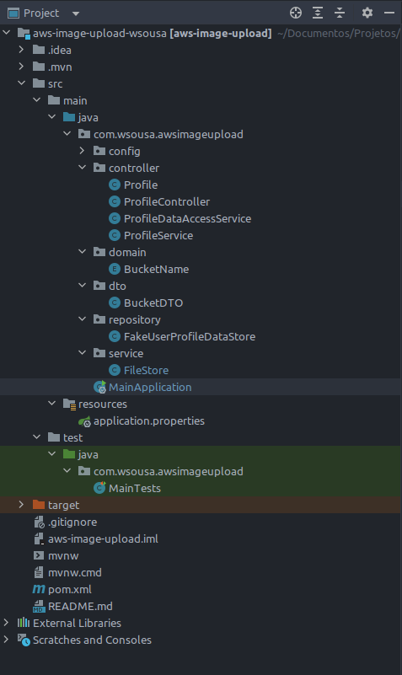
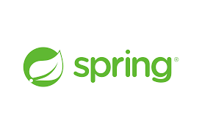




Archicteture BackEnd
BackEnd

Slide 24
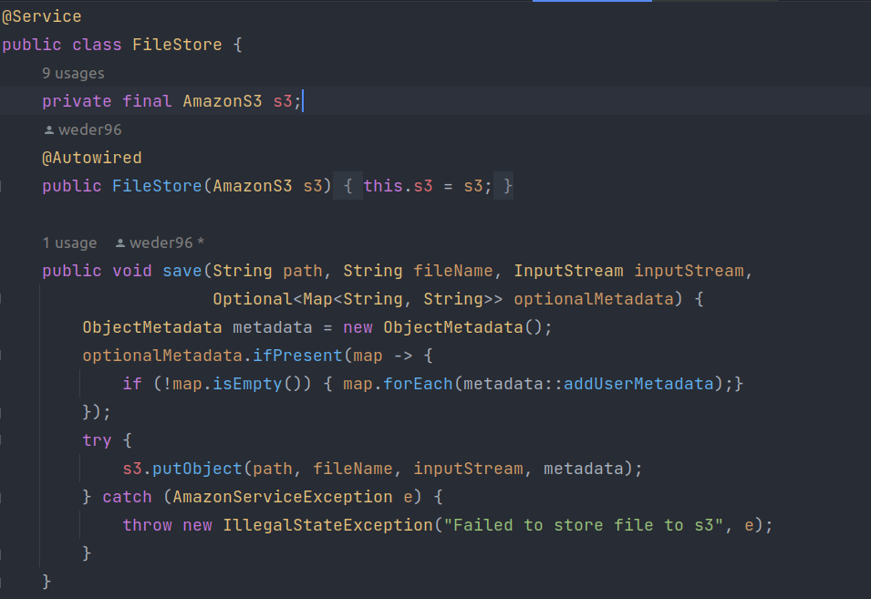
Upload File Bucket

Slide 25
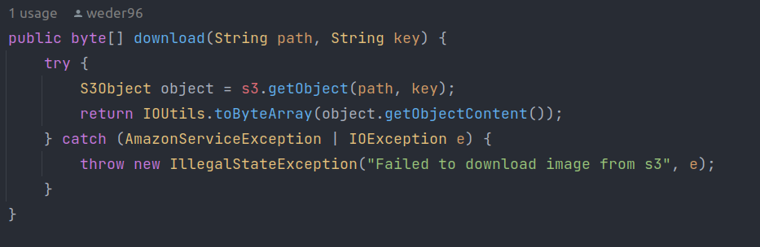
Download File Bucket

Slide 26
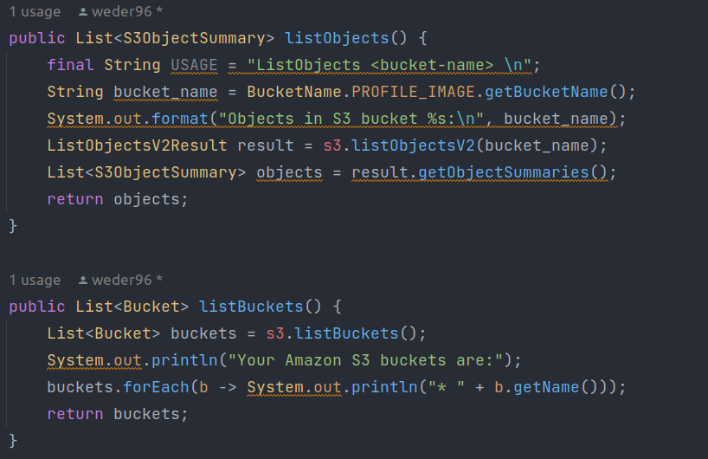
List Objects and Bucket

Slide 27
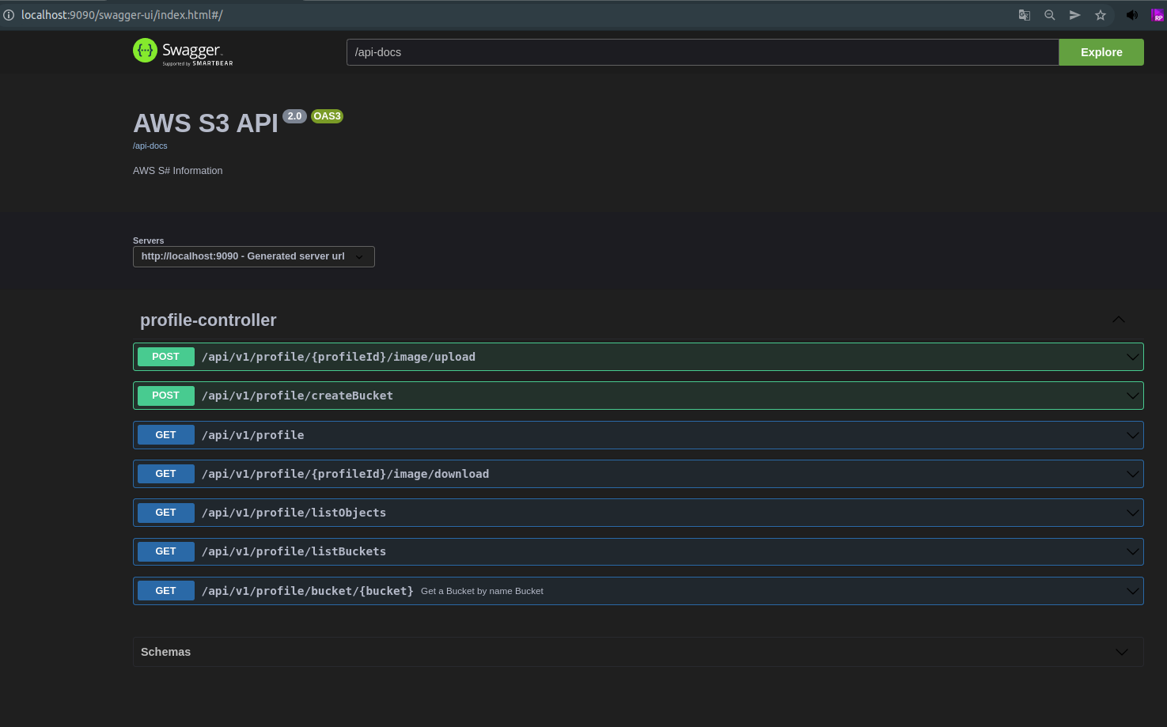
Swagger - Open ui v3

Slide 28

And finally…

Slide 29
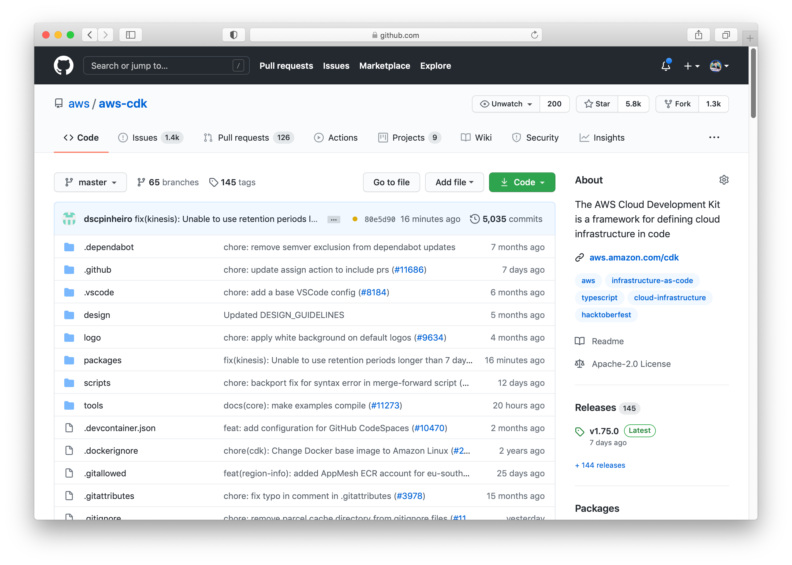
Best Practice: Contribute

Slide 30
Resources
Get Started with the AWS CDK AWS CDK Online Workshop AWS CDK Samples on GitHub
https://cdkworkshop.com
https://github.com/aws-samples/aws-cdk-examples
Dive Deeper
GitHub
https://github.com/aws/aws-cdk
CDK Pipelines
https://aws.amazon.com/blogs/developer/cdk-pipelines-continuous-delivery- for-aws-cdk-applications/
Sample Code in this presentation
https://github.com/rix0rrr/devoops-sample
A Landing Zone Implemented with CDK
https://github.com/aws-samples/aws-secure-environment-accelerator
Testing infrastructure with the CDK https://aws.amazon.com/blogs/developer/testing-infrastructure-with-the-aws- cloud-development-kit-cdk/
© 2020, Amazon Web Services, Inc. or its Affiliates. All rights reserved. Amazon Confidential and Trademark.

Slide 31
Weder Mariano de Sousa
Q&A
Center Leader Specialist Senior - NTTDATA
GOJava
AWS User Group Goiânia
https://www.linkedin.com/in/wedermarianodesousa/
https://github.com/weder96

Slide 32
THANK YOU

